Slide 1
Inclusive by Design:
when AI reshapes the first rung
with James Walters, MTC FutureReady

Slide 2

Presentation title page
About Australian Disability Network
Australian Disability Network works with organisations across Australia to make workplaces more inclusive for people with disability.
We know that many of you are at different stages of this journey - some are just getting started, others have been working on inclusion for years but want to do more.
You are in the right place!

Slide 4
Presentation title page
Agenda
Welcome and introduction (5 minutes) – Rosie Lane
Welcome from AusDN, Acknowledgement of Country & housekeeping
Conversation (25 minutes)
Rosie - Introduction to today's topic and guest (5 minutes)
Rosie and James in conversation – AI, the first rung and keeping pathways open (20 mins)
Q&A (10 minutes)

Slide 5
Presentation title page
Accessibility Features for this session
Live Captions are available throughout the session via Microsoft Teams. You can turn them on via the three dots labelled ‘More’ on the toolbar, then select ‘Language and Speech
Auslan Interpreters are provided by Deaf Connect.
Recording: This webinar will be recorded and will be shared with the transcript to all registered attendees.

Slide 6
Presentation title page
Housekeeping notes
Chat & Q&A: Chat and Q&A will be monitored, please add questions for James
and Rosie into the Q & A and upvote those that you want answered.
If we don’t get to your question, we will share a FAQ after the event.
Technical issues: If you encounter technical issues during the webinar, please note that we will be sending everyone the recording and transcript.

Slide 7
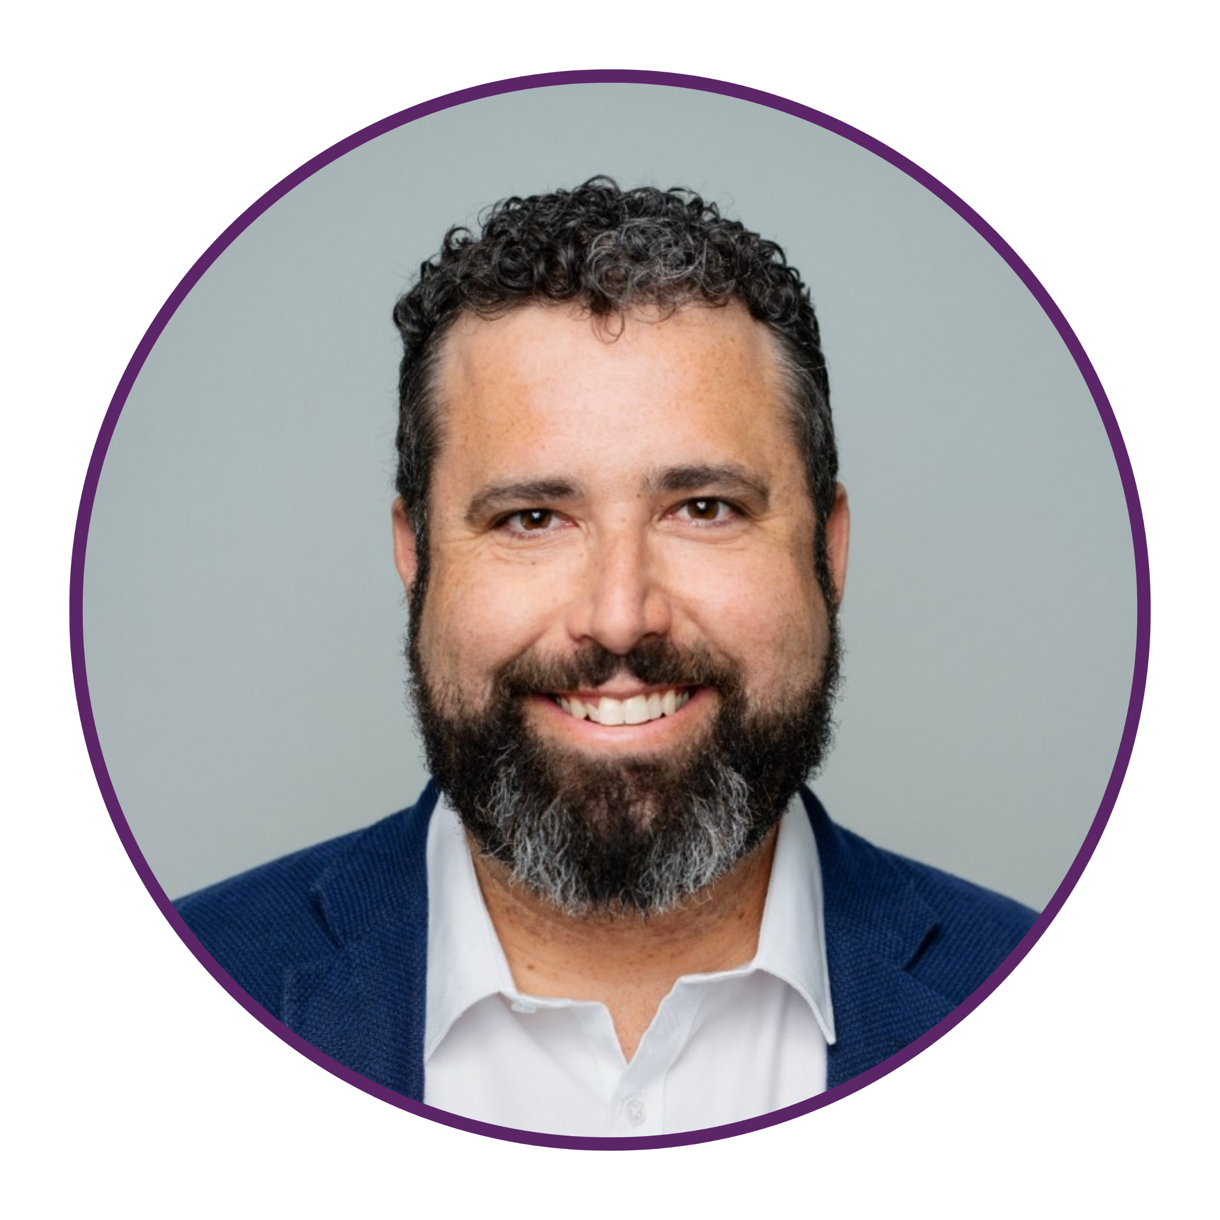
Presentation title page
Introducing today’s speaker
James is a recognised non-profit leader with over 20 years of experience driving social impact across employment, education and disability services.
At MTC FutureReady, he has introduced a data-driven framework that improves outcomes for communities.
He is a sought-after voice on disability, employment and AI.

Slide 8
Presentation title page
Questions you can ask your organisation:
Which entry-level roles or tasks in our organisation are most likely to change because of AI?
Are we helping early-career employees use AI effectively and responsibly, rather than assuming they already know how?
Could AI remove barriers in our hiring process, or might it create new ones?
How will we monitor whether our use of AI is improving or limiting access to employment?
Could our use of AI remove barriers, or might it create new ones?
Have we involved people with disability in designing the solution?

Slide 9
Presentation title page
Q&A

Slide 10
Presentation title page
How AusDN can help:
Internship Program
  Host university students and recent graduates with disability in your organisation
  Build manager capability and highlight strengths and opportunities in your recruitment process
Disability Confident Recruiter® Program
  Systematic review of your end-to-end recruitment process to identify and remove barriers
  Achieve Disability Confident Recruiter status
Career Mentoring Program
  Pairs mentors from your organisation with jobseekers with disability
  Build disability confidence and leadership skills

Slide 11
Presentation title page
If you're looking for ongoing support with your inclusion journey, and you are not yet a member of Australian Disability Network, our Bronze membership is a great place to start.
We give you the framework, community, and ongoing support to create meaningful action.
Find out more: www.AustralianDisabilityNetwork.org.au

