Slide 1

Inclusive by Design Signs of Success – Creating career pathways and progression with Deaf Connect

Slide 3
Agenda
Welcome and housekeeping notes – Sarah Wojciechowski, AusDN
Introduction to guest speakers – Sarah Wojciechowski, AusDN
Discussion – Isabelle Swanston and Brent Phillips from Deaf Connect
Q & A – Facilitated by Sarah Wojciechowski, AusDN
Wrap-up and close – Sarah Wojciechowski, AusDN

Slide 4
Accessibility features for this session
Live Captions are available through Captify
Auslan Interpreters are provided by Deaf Connect.

Slide 5
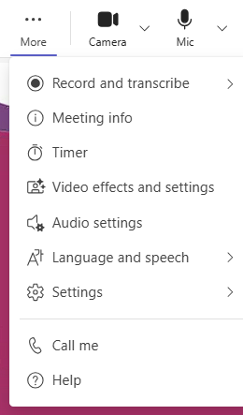
Accessibility features for this session
To turn on Sign language mode 1. In Teams on laptop or desktop, select More … (3 dots at the top right hand of the screen)

Slide 6
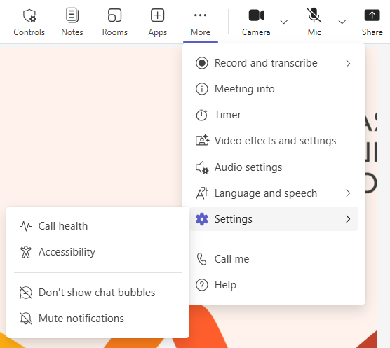
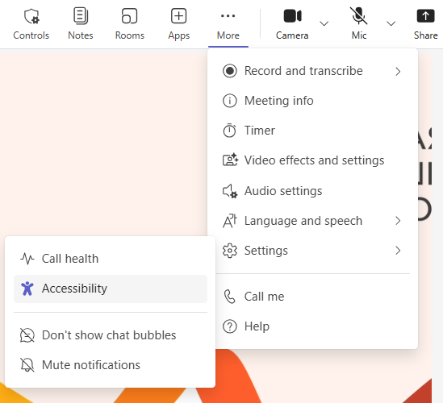
Accessibility features for this session
2. Select Settings > Accessibility.

Slide 7
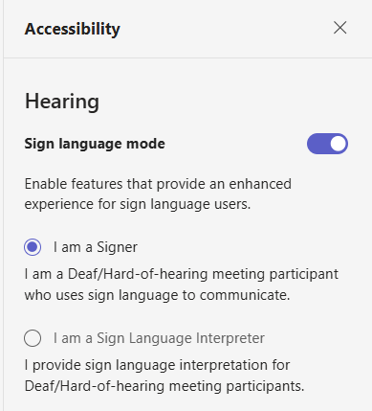
Accessibility features for this session
3. Turn on Sign language mode toggle button and select Signer

Slide 8
Accessibility features for this session
Pop out feature
Select the pop out button and content will open in a separate window, allowing you to view it without blocking the main meeting view.
Recording: This webinar will be recorded and will be shared with the transcript to all registered attendees.

Slide 9
Housekeeping notes
Chat & Q&A: Chat and Q&A will be monitored. Please add questions for Sarah and our panelists into the Q & A and upvote those that you want answered. If we don’t get to your question, we will share a FAQ after the event.
Technical issues: If you encounter technical issues during the webinar, please note that we will be sending everyone the recording and transcript.

Slide 10
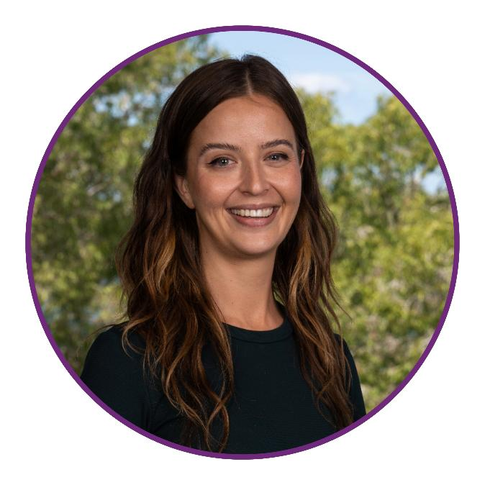
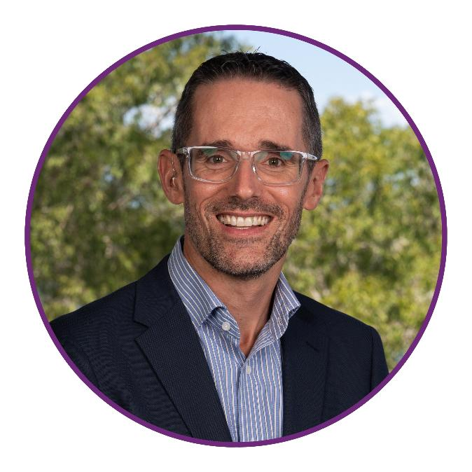
Introducing today’s speakers
Isabelle Swanston Chief People Culture Officer
Brent Phillips Chief Services Officer

Slide 11

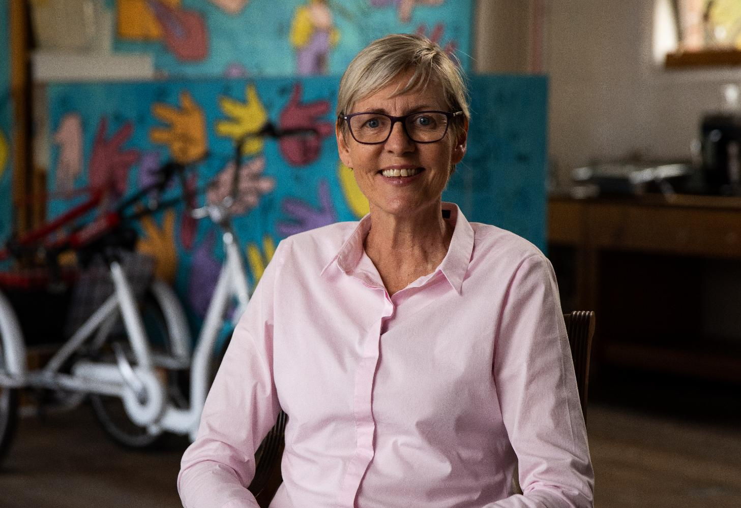
The BEC Project – At a Glance
Funded by the Australian Government Department of Health, Disability and Ageing under an Information Linkages & Capacity Building (ILC) Grant – Building Employer Confidence (BEC).
Key Deliverables:
Deakin University Research Report
Evidence based employer handbook: Building Inclusive Workplaces
Signs of Success docuseries
Image 1: Marg Tope, Principal, Victoria College of the Deaf
Notes:
Belle:
Deakin University research report: Aimed to understand the experiences, challenges and opportunities faced for deaf and hard of hearing people in the workplace from the perspectives of both employees and employers
Evidence based employer handbook: Based on the research conducted by Deakin University. Provides practical guidance for managers across the seven stages of the employment lifecycle.
Signs of Success docuseries: Showcasing successful, real life case studies of organisations that have embraced inclusive, deaf friendly workplaces.

Slide 12
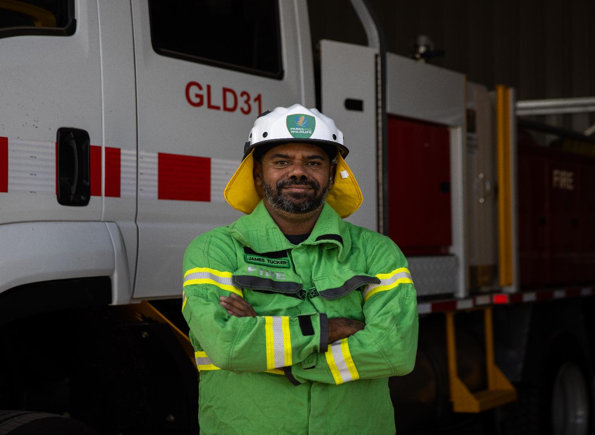
Why This Matters for Employers
Creating an inclusive workplace starts with understanding the experiences of Deaf and Hard of Hearing employees and the barriers they commonly face.
Employers care about getting this right but often feel unsure about communication, adjustments and where to begin.
This presentation brings together research, real workplace stories and practical tools to help employers build confidence and create environments where everyone can participate fully.
Image 2: Ranger James Tucker from Goldfields Region Parks & Wildlife Service, part of the Western Australia Government Department of Biodiversity, Conservation & Attractions (DBCA)
Notes:
Belle

Slide 13
The Value of Inclusive Workplaces
Higher performance
Disability‑inclusive organisations achieve 1.6× higher revenue, 2× economic profit, and 2.6× net income compared to peers.¹
Boosts innovation
Inclusive teams are 6× more innovative and 3× more likely to be high‑performing.²
Access to talent
Taps into a large, motivated talent pool who are often excluded due to workplace barriers.³
Better culture & retention
Inclusion strengthens morale, engagement, and retention across the whole workforce.³
Stronger brand & customer reach
Inclusive organisations earn greater trust, loyalty, and market differentiation.²
Source:
¹ Accenture & Disability:IN — Disability Inclusion Imperative
² Deloitte findings summarised by Canadian Hearing Services — Business Case for Accessibility
³ Lifeworks — The Business Case for Disability Inclusion
Notes:
Belle

Slide 14

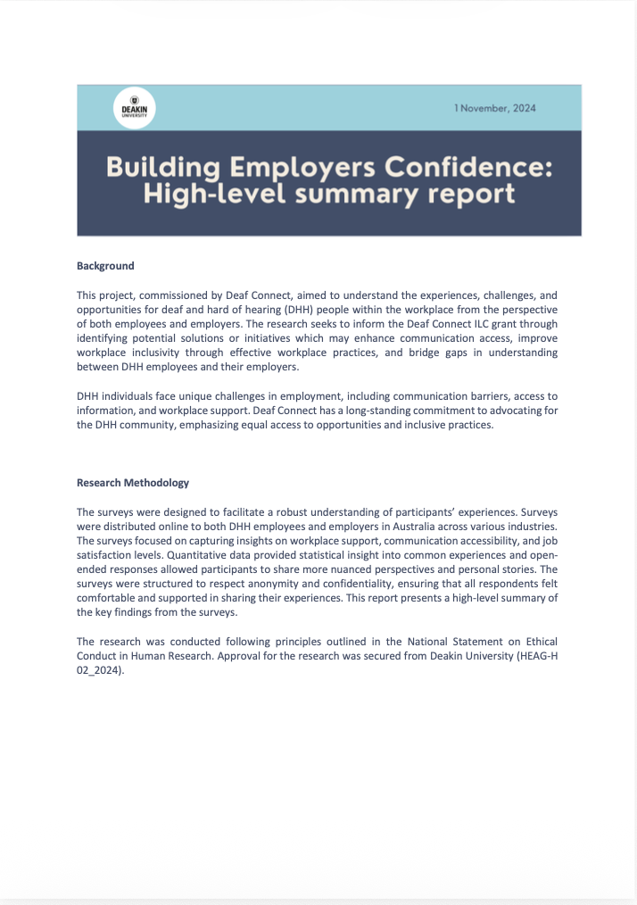
Deakin University Research
Deakin University conducted independent research for Deaf Connect to understand the real‑world experiences of Deaf and Hard of Hearing employees and the employers who support them.
The national study gathered both quantitative data and detailed personal insights through national surveys, helping identify the key challenges, opportunities, and workplace adjustments that make the biggest difference.
The research provides the evidence base for the Signs of Success project, ensuring all recommendations are grounded in lived experience and employer feedback.
Communication barriers:​
The #1 challenge reported by employers ​
​
Image 3: Deakin University Research Report: Building Employers Confidence: High-level summary report.
Notes:
Brent

Slide 15

Deakin University Research Findings
Communication modes
59% of Deaf employees rely on mixed communication methods at work.​
Interpreter shortage
Employers say lack of interpreters prevents equal participation.​
Promotion barriers
Deaf staff are unable to be promoted in roles which require verbal/written communication.​
Fatigue
Deaf employees face high cognitive load due to the constant effort required to communicate in the workplace.
54% of employers reported increased confidence once reasonable adjustments were implemented.
Notes:
Brent

Slide 16
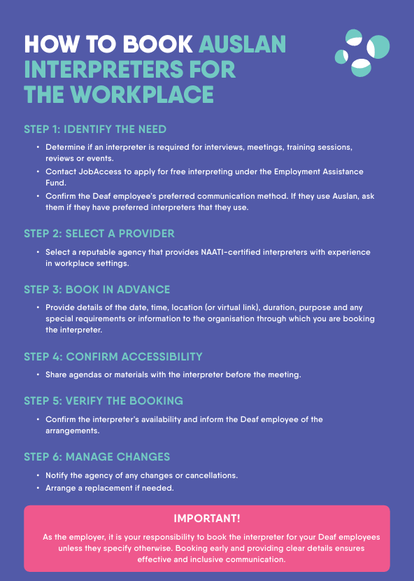
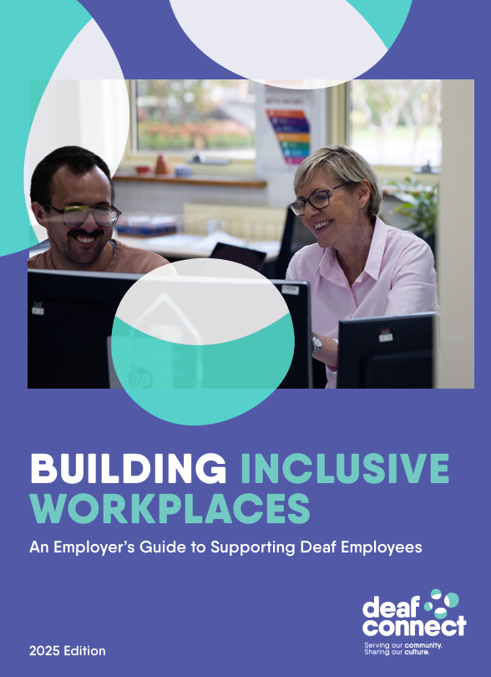
Building Inclusive Workplaces
The Building Inclusive Workplaces handbook provides employers with a practical guide to address common challenges employers face when hiring and supporting Deaf staff.
Designed as a go‑to resource, the handbook helps employers build confidence and foster workplaces where Deaf employees can participate fully and thrive.
What the handbook includes:
Step‑by‑step guidance across the stages of the employment lifecycle
Practical strategies and examples for how employers can make their workplaces accessible
Information on technologies and supports available for employers to access including interpreters, captioning, assistive tools, Deaf Awareness Training and government programs such as the Employee Assistance Fund (EAF)
Image 4: The front cover and an excerpt from the Building Inclusive Workplaces Handbook.
Notes:
Belle

Slide 17
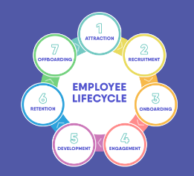
The Lifecycle of Inclusive Practice
Job Advertisements
Plain language and visual cues
Offer adjustments upfront
Interviews
Interpreter availability is often a barrier
Booking early avoids delays.
Onboarding
Clear onboarding matters (e.g. Auslan, captions, chat)
Assign a buddy
Meetings
Book interpreters or captioning early
Share agendas
Technology
Enable live captions
Confirm chat visibility and recording accessibility
Performance & Growth
Accessible feedback
Training pathways
Mentorship
Image 5: An excerpt from the Building Inclusive Workplaces Handbook.
Notes:
Belle

Slide 18

Signs of Success Docuseries
The Signs of Success docuseries showcases real-life examples of employers across Australia who have implemented inclusive practices that genuinely work for Deaf and Hard of Hearing employees.
Through short, engaging documentary‑style episodes, the series highlights practical adjustments, supportive leadership, and the positive organisational outcomes that emerge when communication access is prioritised.
The docuseries offers employers relatable models to follow, reinforcing that Deaf inclusion is achievable, impactful, and beneficial for teams and organisational culture.
Image 6: Footage taken from various Signs of Success episodes.
Notes:
Brent
30 sec promo video

Slide 19
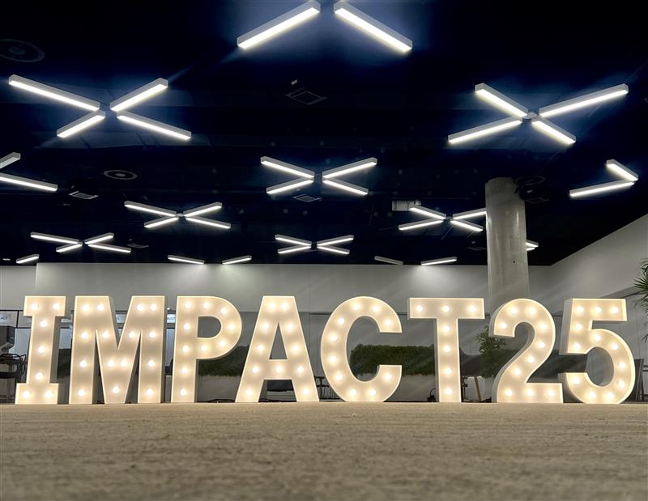
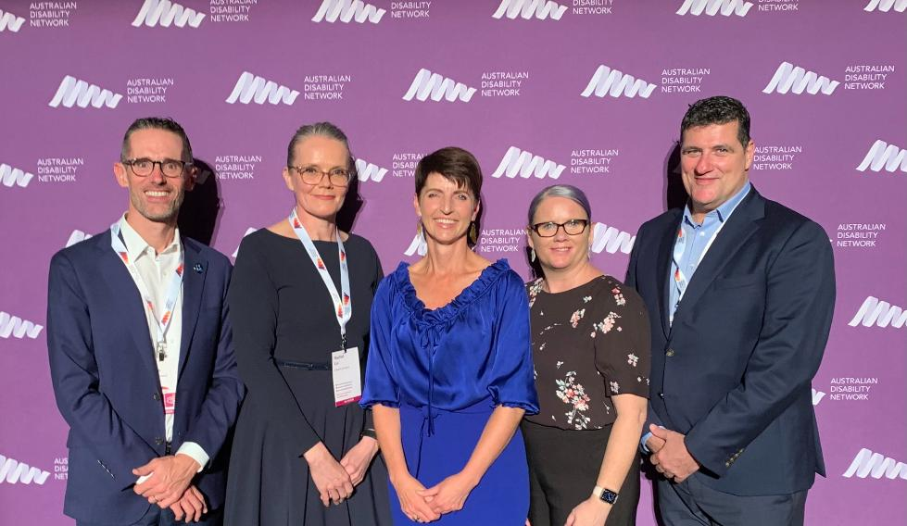
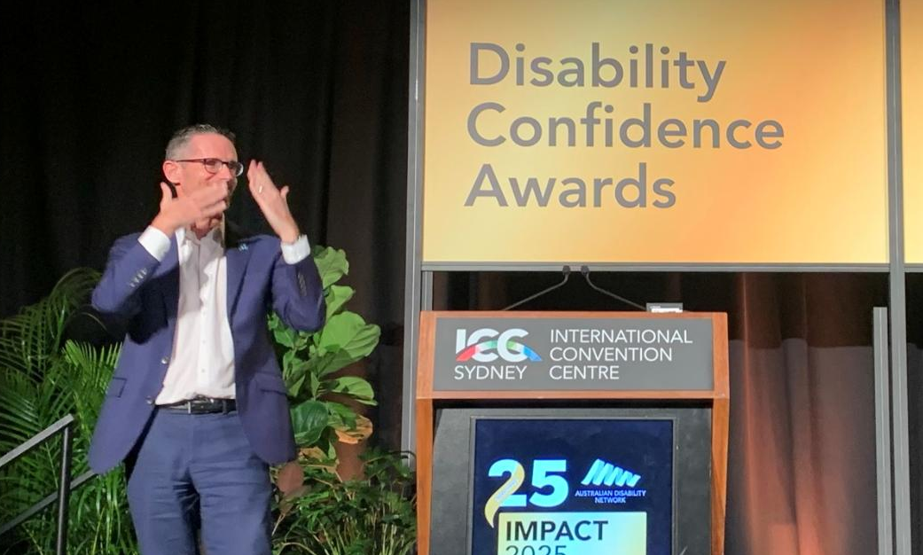
Launch & Early Impact
The Signs of Success initiative was officially launched on 12 May at the Australian Disability Network (ADN) Impact Summit 2025.
A valuable opportunity to build connections with likeminded employers and highlight ADN’s role in strengthening inclusive practice.
The launch generated high interest and strong digital engagement.
95,510 Facebook views & 3,152 click throughs to our website in the first month from launch.
248,225 LinkedIn impressions & 3,215 click throughs to our website in the first month from launch.
Image 7: Deaf Connect with the Hon. Kate Washington MP, Member for Port Stephens & New South Wales Minister for Disability & Inclusion
Image 8: Brent Phillips addressing the ADN Impact Summit, introducing Signs of Success​
Notes:
Brent:
It was fantastic to launch Signs of Success at the ADN Impact Summit, it gave us the chance to connect with organisations who really care about inclusion.
ADN continues to play a key role in creating these spaces, and we’re grateful for the opportunity.

Slide 20
Upcoming Webinars with JobAccess
Employers Webinar
When | Wednesday, 11 March
Time | 11am to 12pm AEST
Register | JobAccess Employer Webinar Link
Employees Webinar
When | Wednesday, 18 March
Time | 11am to 12pm AEST
Register | JobAccess Employee Webinar Link
Notes:
Brent

Slide 21
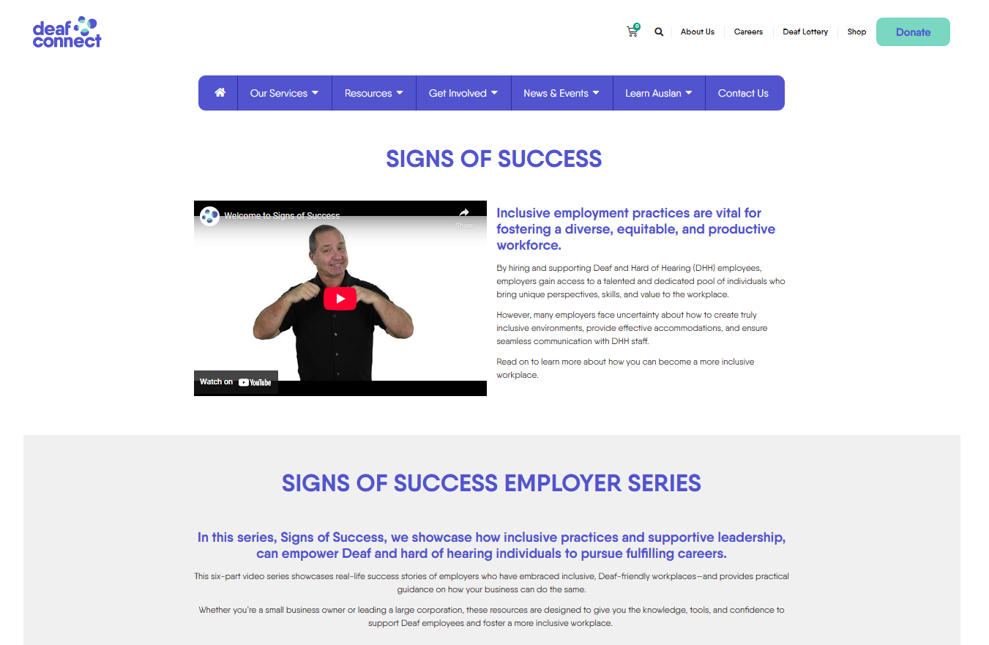

Signs of Success Webpage
QR CODE
Visit the website:
https://deafconnect.org.au/signs-of-success
Image 9: Signs of Success page on Deaf Connect’s website
Notes:
Brent

Slide 22
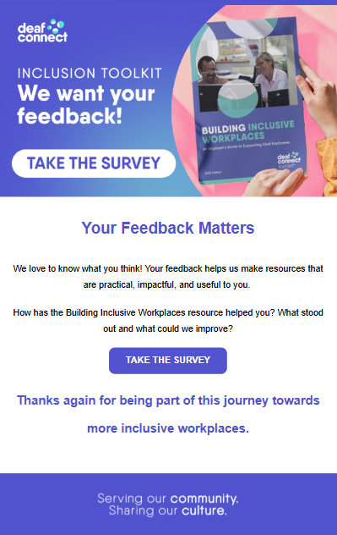
Why Your Feedback Matters
When you download the employer handbook you will be emailed a link to complete an employer survey.
This survey allows us to:
Understand whether these challenges are being effectively addressed.
Help us refine and improve our resources.
Helps us to ensure the toolkit continues to meet employer needs.
Ensures that our resources continue to support organisations to build more inclusive workplaces which enable Deaf employees to thrive.
Image 10: Employer Survey Email
Notes:
Belle

Slide 23
Discussion and Q & A Facilitated by AusDN

