Slide 1

Presentation title page
Inclusive by Design
Accessible wayfinding: removing barriers
and enabling inclusion with BindiMaps
with Dr Anna Wright, CEO and Founder of BindiMaps.

Slide 2
Acknowledgement of Country

Slide 3

Presentation title page
Agenda
Housekeeping notes – Tom Bevan, AusDN
Introduction to guest speaker – Tom Bevan, AusDN
Discussion – Tom Bevan, AusDN and Dr Anna Wright, Bindimaps
Q & A – Facilitated by Tom Bevan, AusDN
Wrap-up and close – Tom Bevan, AusDN

Slide 4
Presentation title page
Accessibility Features for this session
Live Captions are provided by Deaf Connect
Auslan Interpreters are provided by Deaf Connect.
Recording: This webinar will be recorded and will be shared with the transcript
to all registered attendees.

Slide 5
Presentation title page
Housekeeping notes
Chat & Q&A: Chat and Q&A will be monitored, please add questions for Tom and Anna into the Q & A and upvote those that you want answered.
If we don’t get to your question, we will share a FAQ after the event.
Technical issues: If you encounter technical issues during the webinar, please
note that we will be sending everyone the recording and transcript.

Slide 6
Presentation title page
Introducing today’s speaker
Dr Anna Wright is the CEO and founder of BindiMaps, a digital indoor wayfinding platform that helps anyone navigate complex indoor spaces, whether they walk or roll, whether they can see or not.
Since 2017, she has grown BindiMaps into a globally recognised accessibility innovator, most recently named a Global Champion at the United Nations World Summit Awards 2023.
A passionate advocate for inclusion and impact-driven technology, Anna is a prominent leader in the startup ecosystem, inspiring others to build tech that changes the world.

Slide 7
Presentation title page
Discussion
Facilitated by Tom Bevan, AusDN

Slide 8
Presentation title page
Q&A
Facilitated by Tom Bevan, AusDN

Slide 9
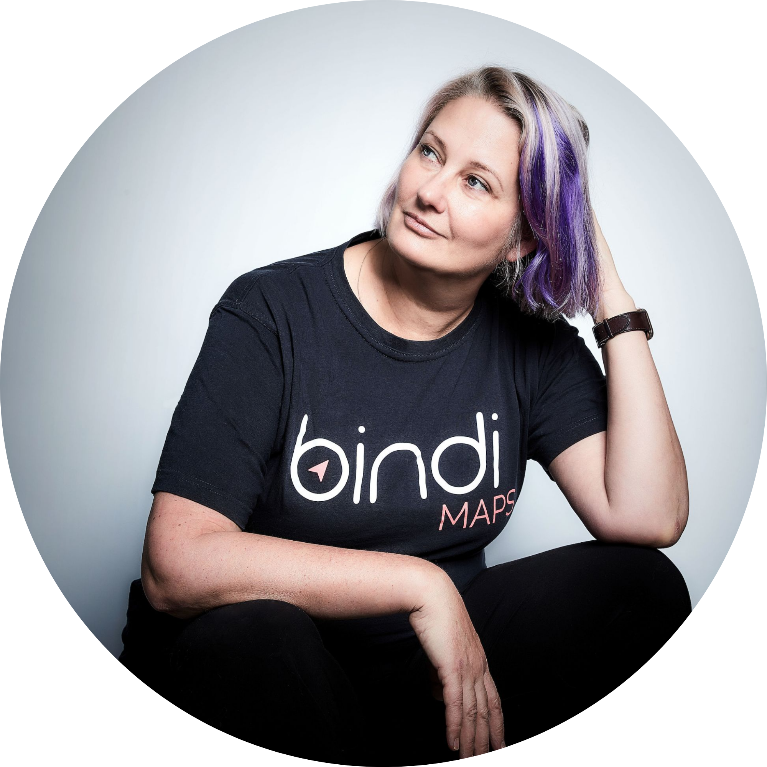
Presentation title page
For more information you can
reach out to Dr Anna Wright at:
anna@bindimaps.com
bindimaps.com

Slide 10
Presentation title page
If you're looking for ongoing support with your inclusion journey, and you are not yet a member of Australian Disability Network, our Bronze membership is a great place to start.
We give you the framework, community, and ongoing support to create meaningful action.
Find out more: www.AustralianDisabilityNetwork.org.au

