Slide 1
Audio via Teleconference Only: Call: 1800 896 323 Pin: 13226340
The Secret to an Inclusive Workplace
Notes:
Welcome! As people arrive, engage them and ask questions
Get them to introduce themselves - name, company, role, location.
Ok, thank you for joining us, I think we have everyone online and dialled in via phone. We will be using the webinar system to take you through the slides and the teleconference for audio, so please double check you are signed into both.
Good morning everyone and welcome to Australian Network on Disability’s webinar – The Secret to an Inclusive Workplace.
Before I hand over to Sam to do the welcome and Kevin for the presentation, a few notes about the system.

Slide 2
The Secret to an
INCLUSIVE WORKPLACE
with
KEVIN FIGUEIREDO

Slide 3
Will get hurt and cause safety issues Not productive Difficult to manage performance Not reliable Are in wheelchairs Union will not accept it
Beliefs

Slide 4
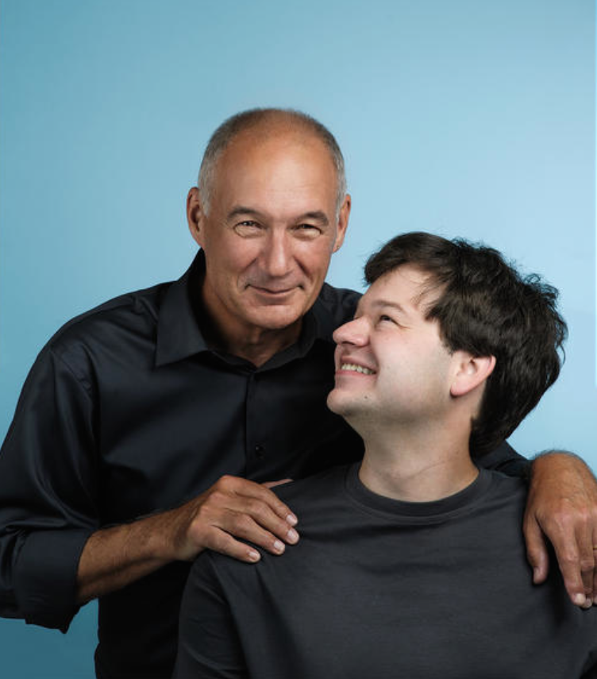
My
ah ha moment!

Slide 5
Removing the fear of failure

Slide 6
$71.6 billion in sales 63 million retail pharmacy patients per year 6.3 million visitors per day 200K people 8,500+ plus stores 22 distribution centres

Slide 7
3 secrets to creating an inclusive culture
#1
A champion with passion, in a big business
#2
Go BIG, not incremental!
#3
Focus on the person not the process
Greg Wasson – CEO Walgreens – 2009-2014

Slide 8
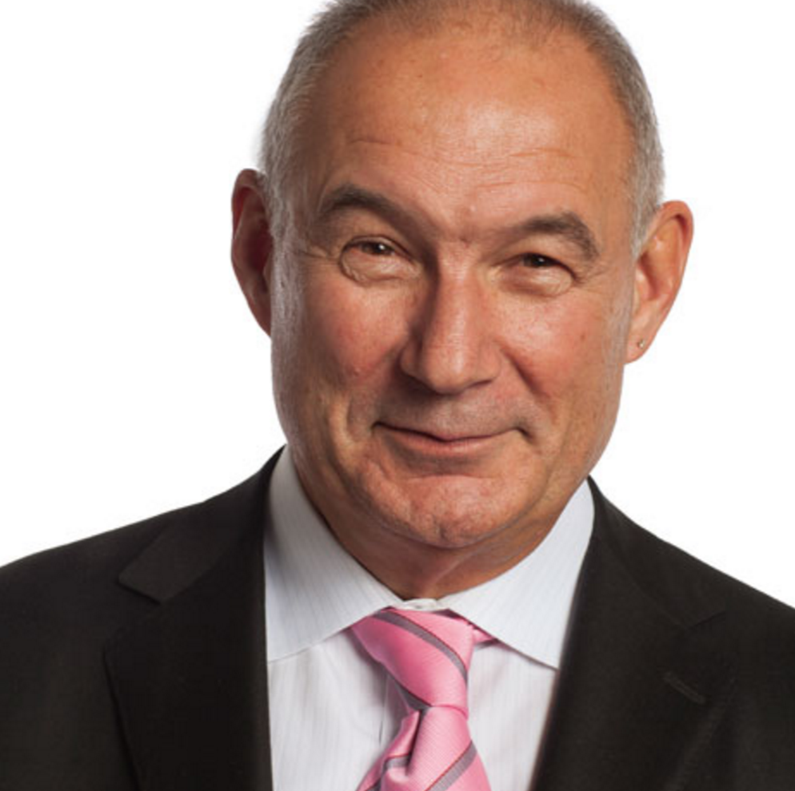
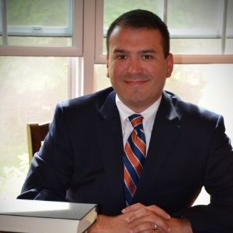
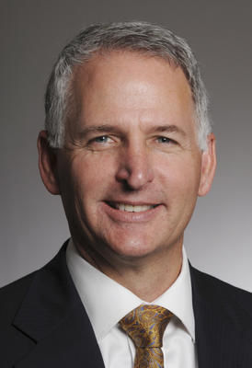
#1 A champion with passion, in a big business
Randy Lewis
VP Supply Chain
Joe Wendover
Field Inclusion Manager
Greg Wasson
CEO

Slide 9
Targets Quotas Ambition Dream
#2 Go BIG, not incremental!
30%

Slide 10
no mascots

Slide 11
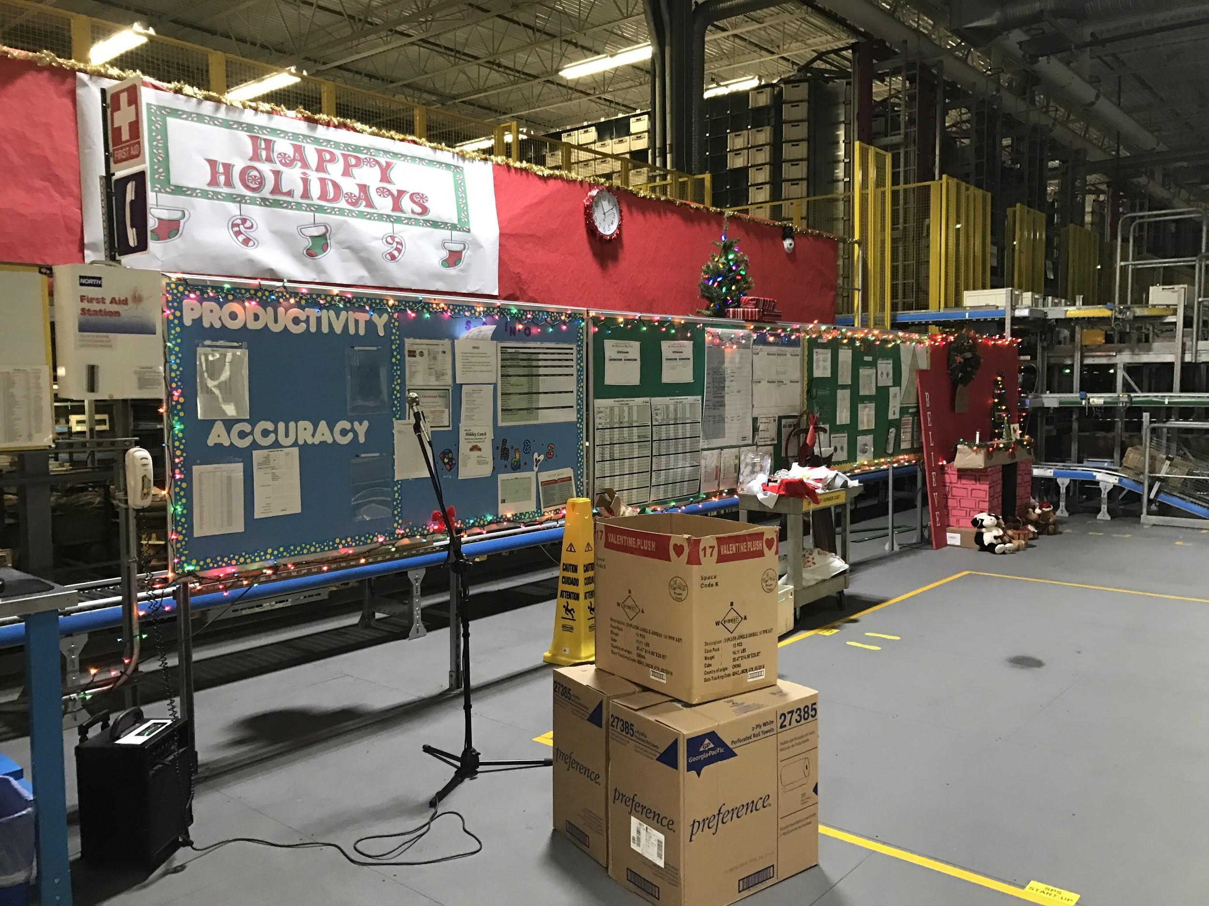
#2 Go BIG, not incremental
Who should be excluded?

Slide 12
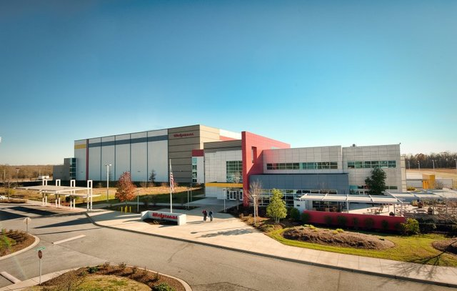
In the beginning there was Walgreens - Anderson, South Carolina

Slide 13
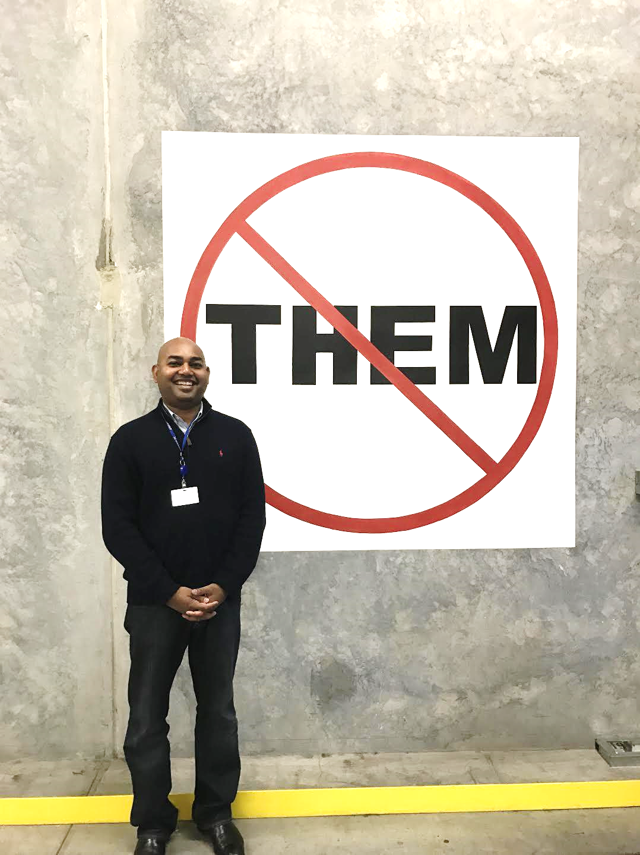
My peers needed proof

Slide 14
#3 Focus on the person not the process
“ATP”

Slide 15
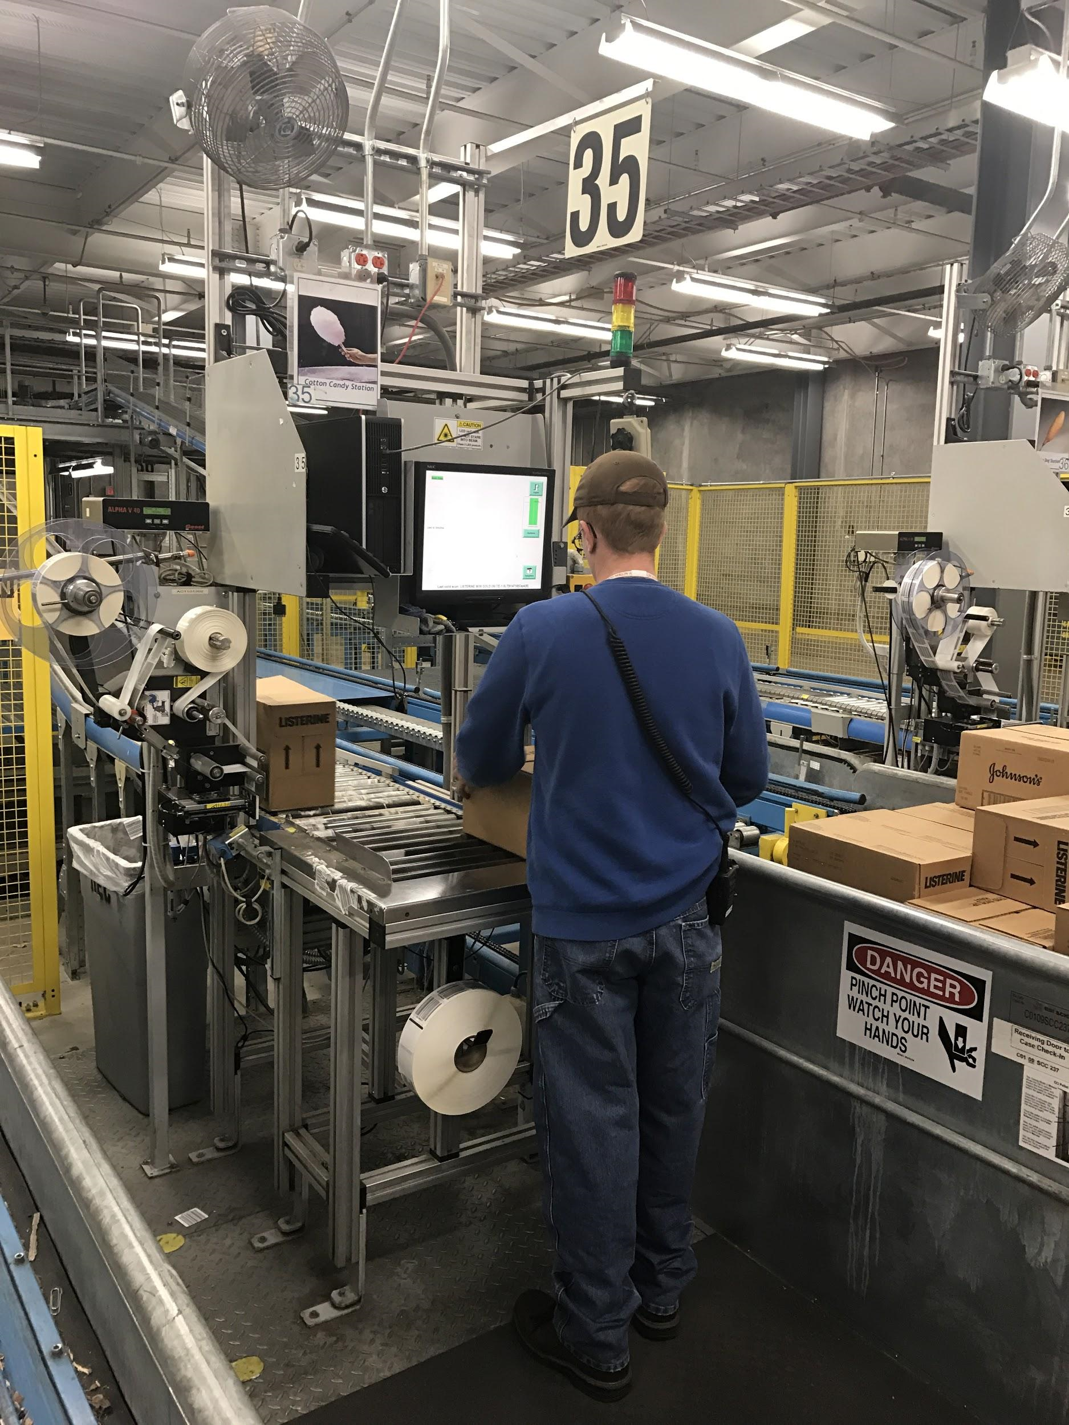
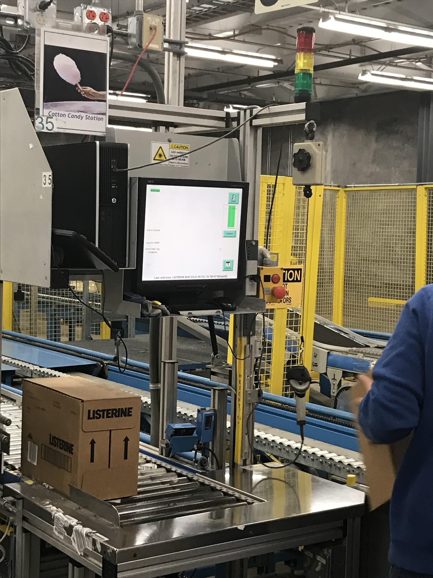
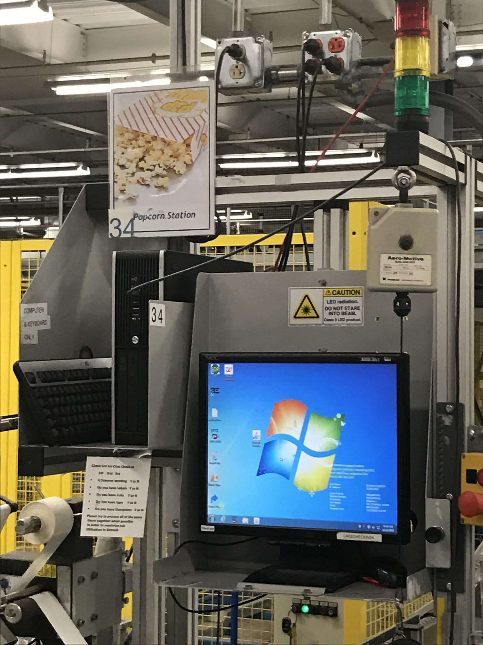
Candyfloss and Popcorn

Slide 16
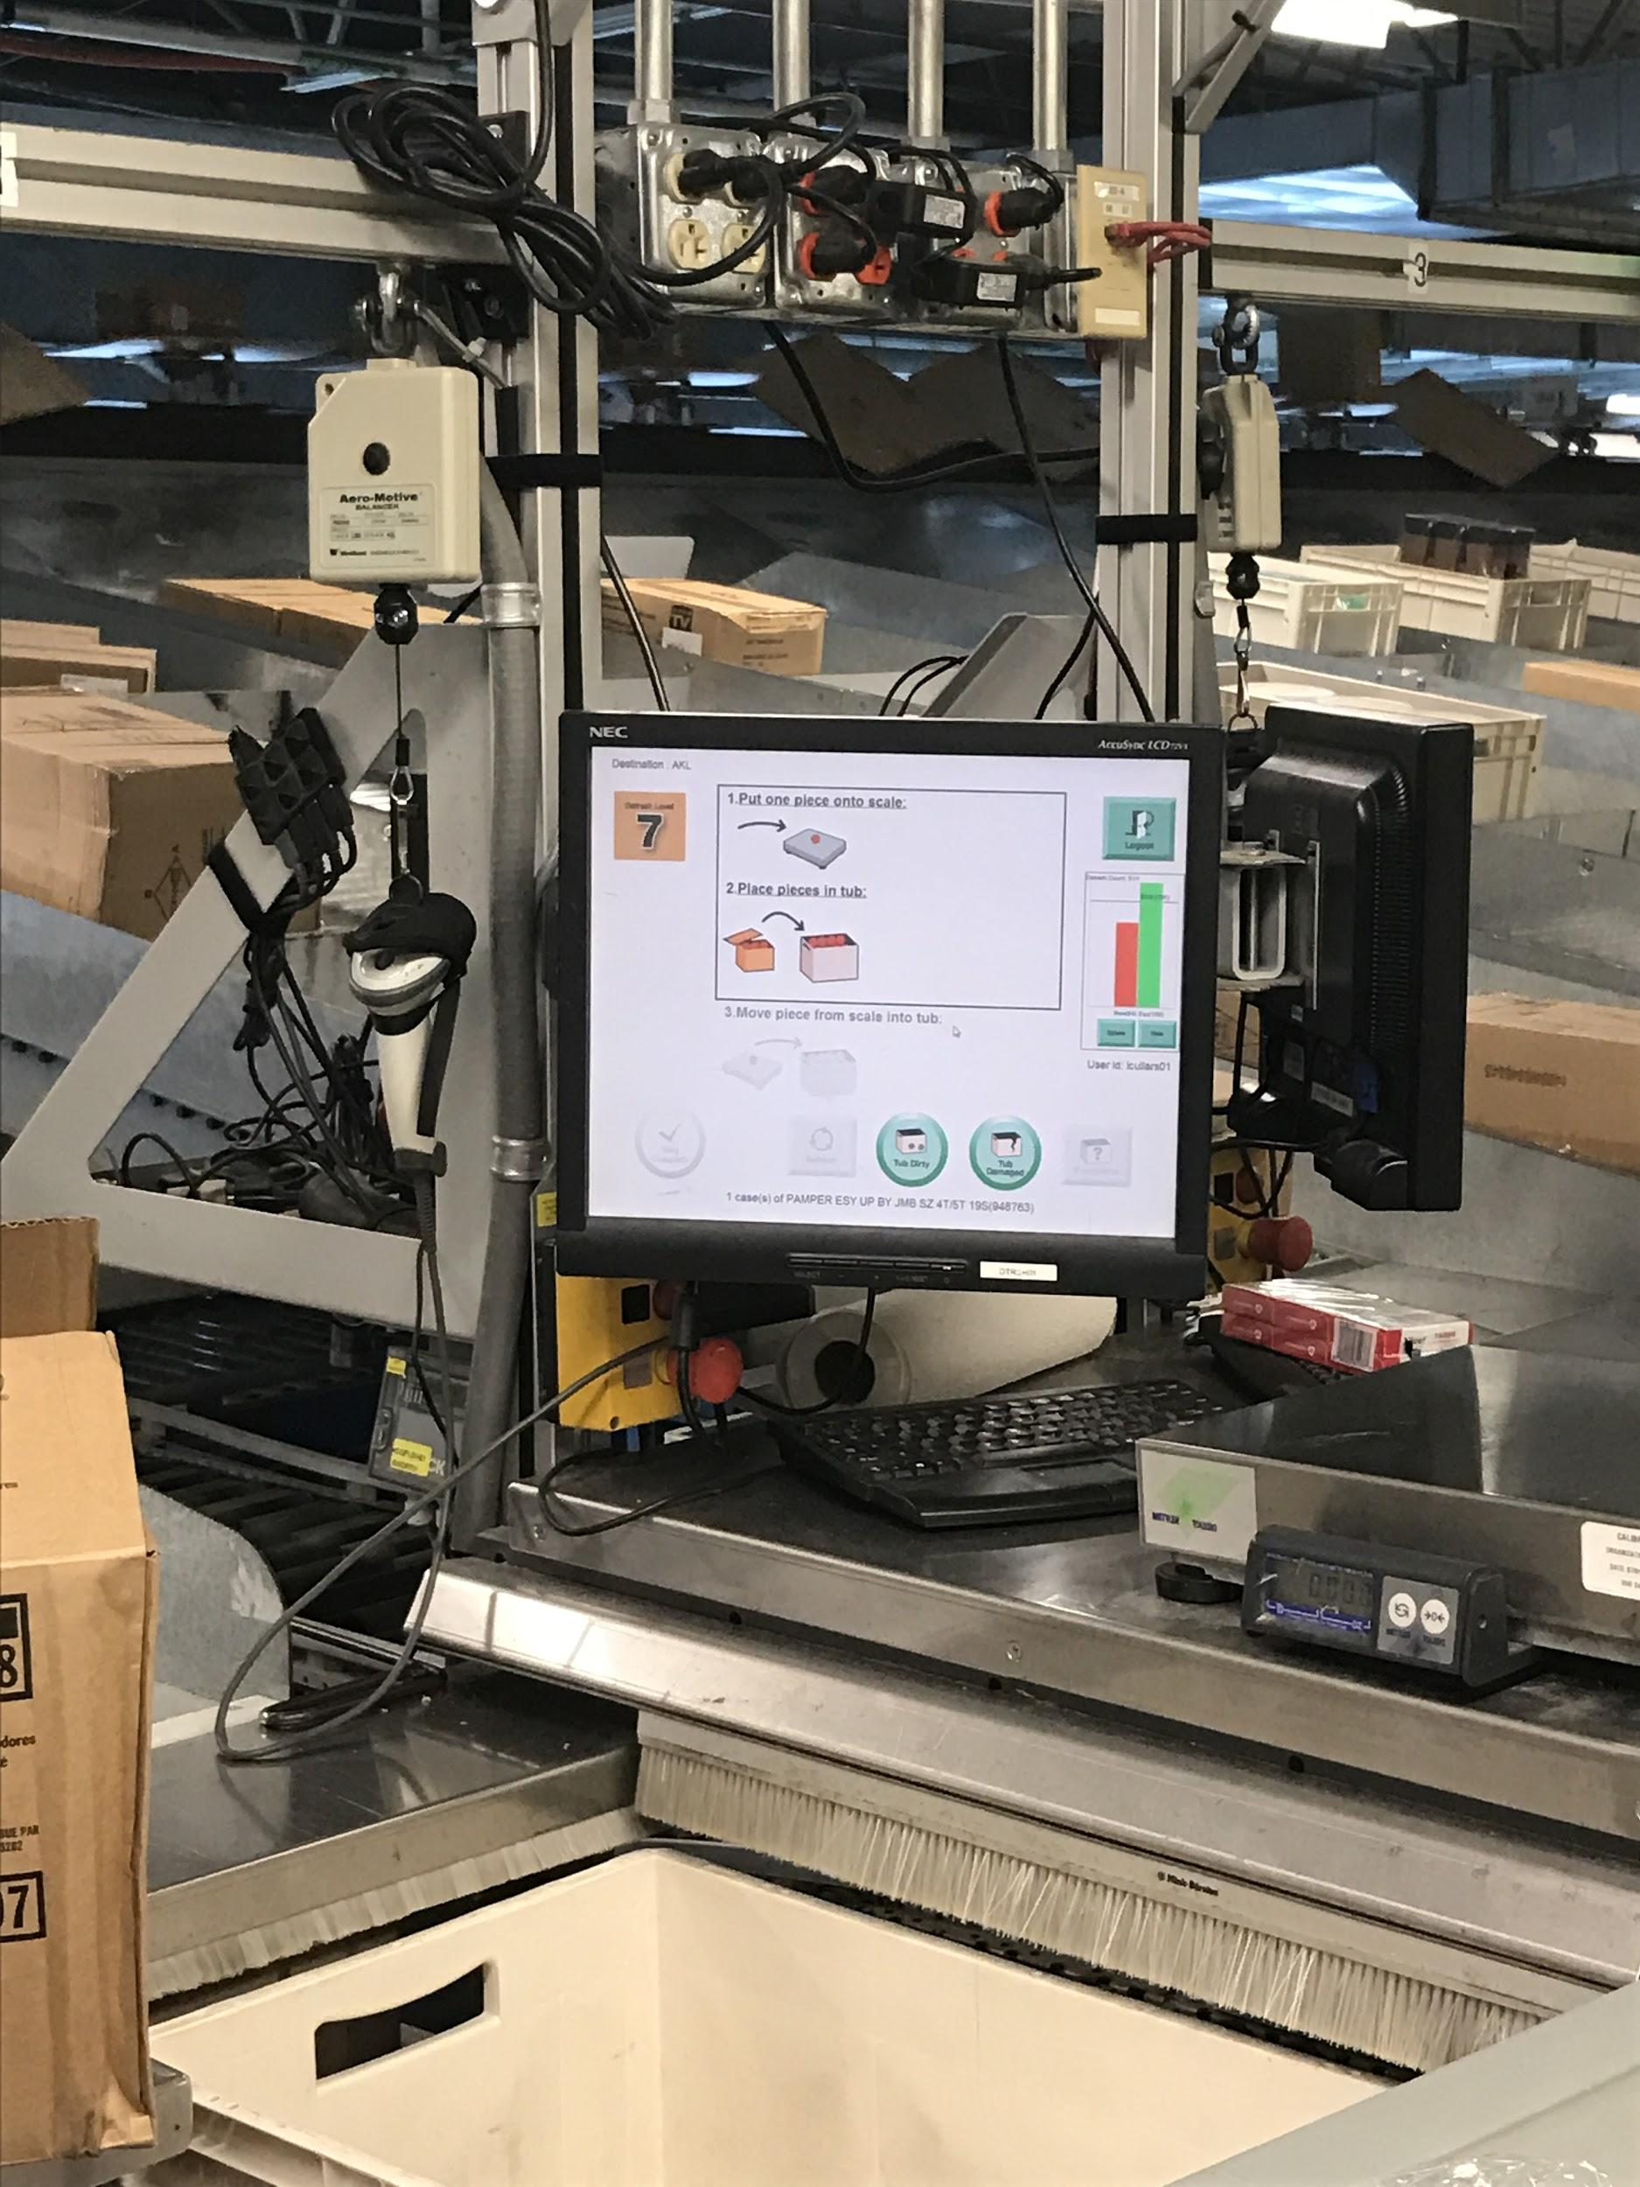
We accept the same standard so we pay the same wages

Slide 17
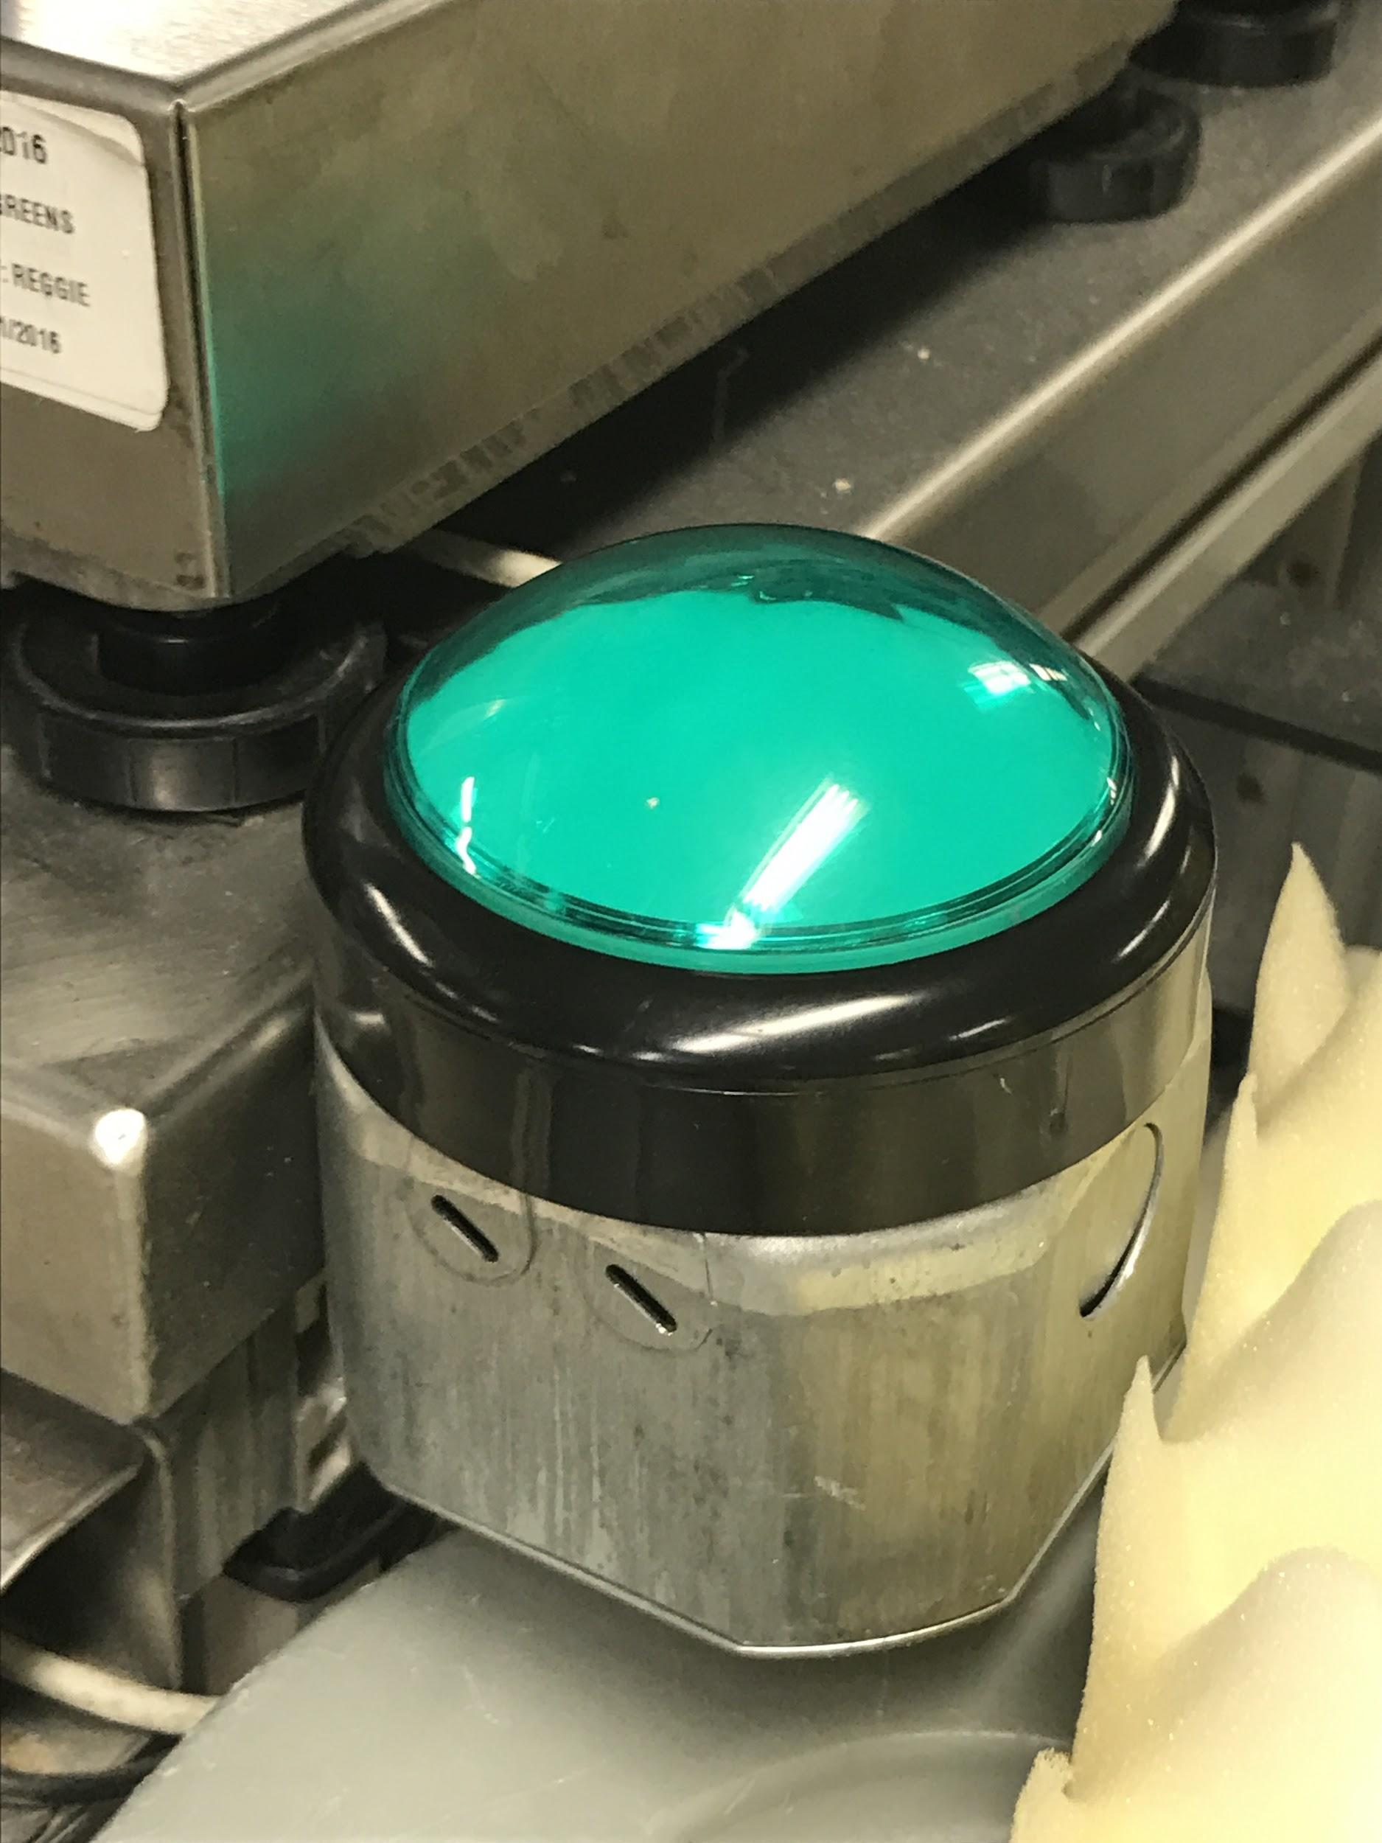
Push my buttons

Slide 18
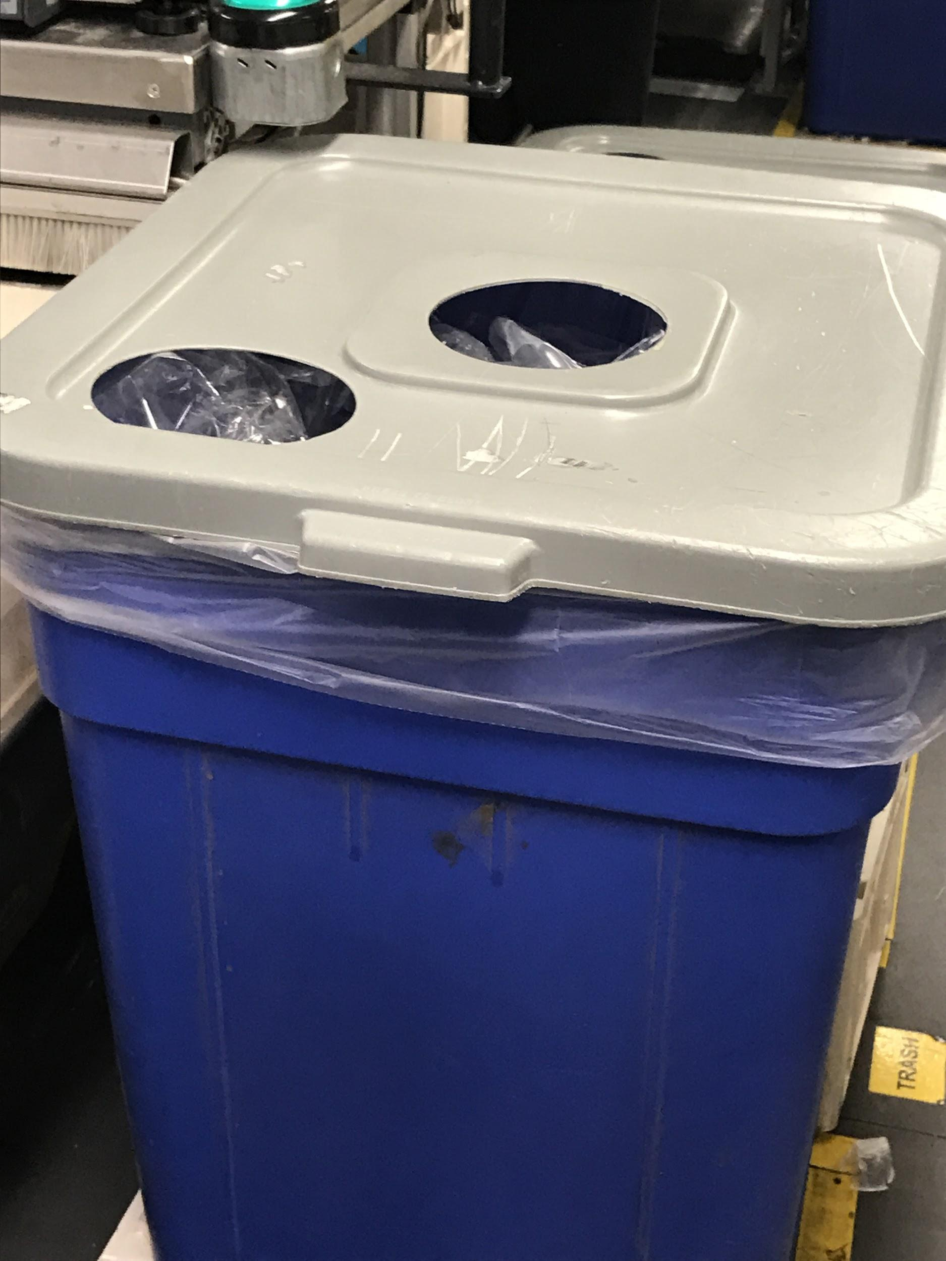
Wrap it up

Slide 19
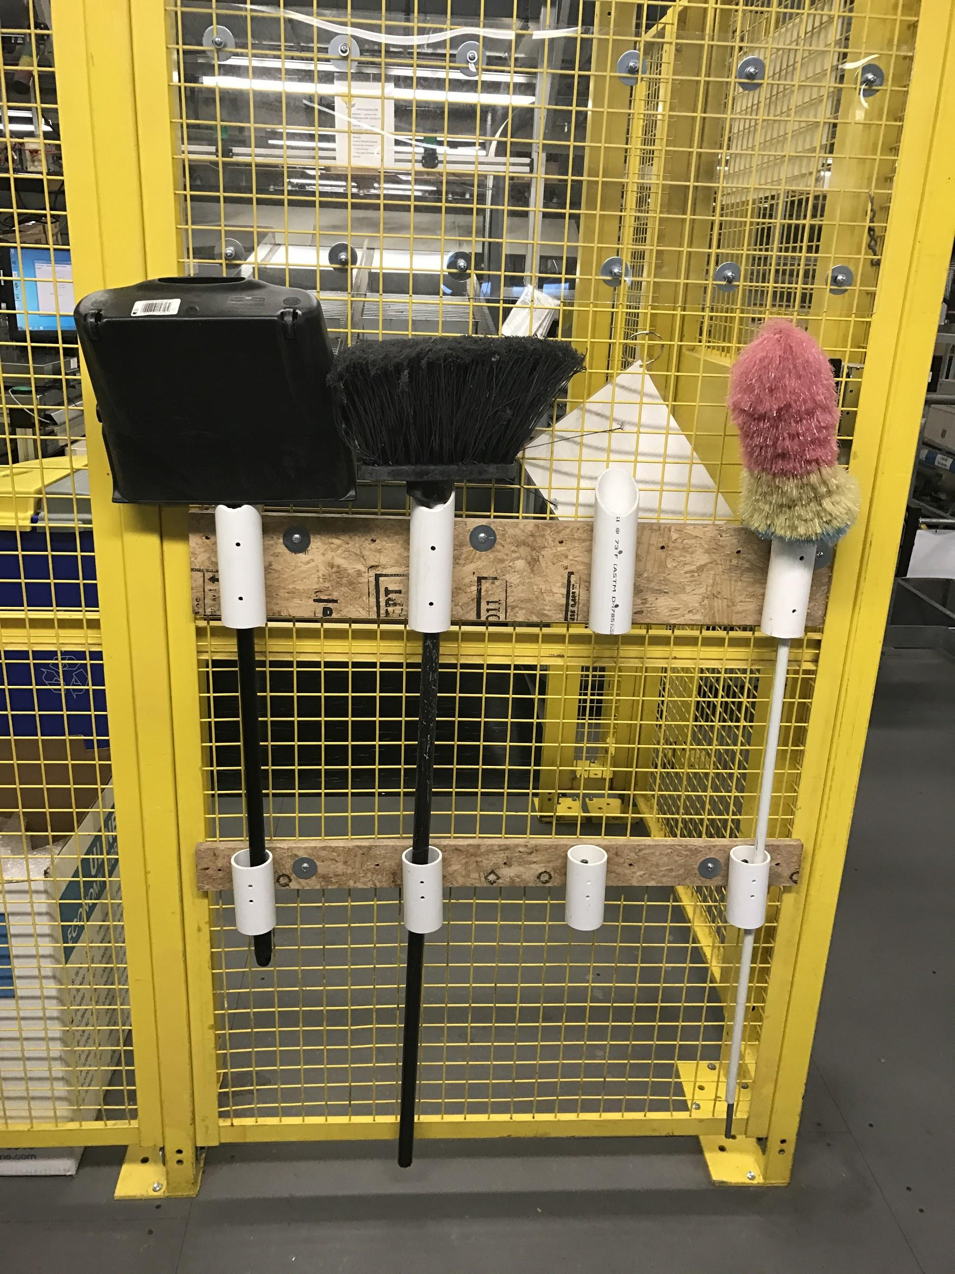
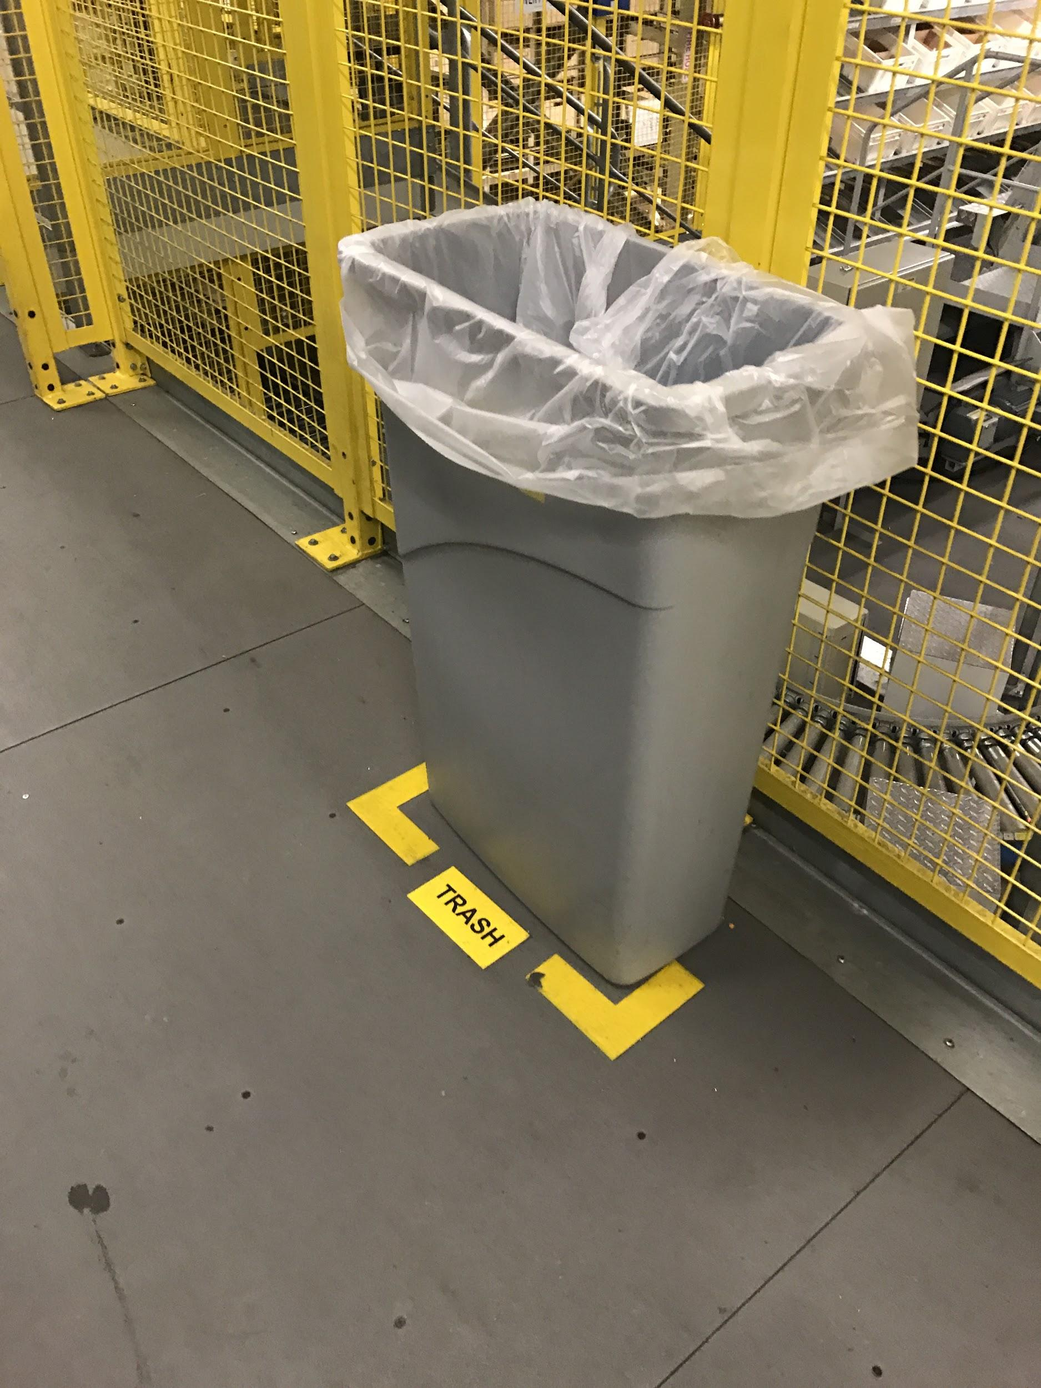
This is my house, this is our house

Slide 20
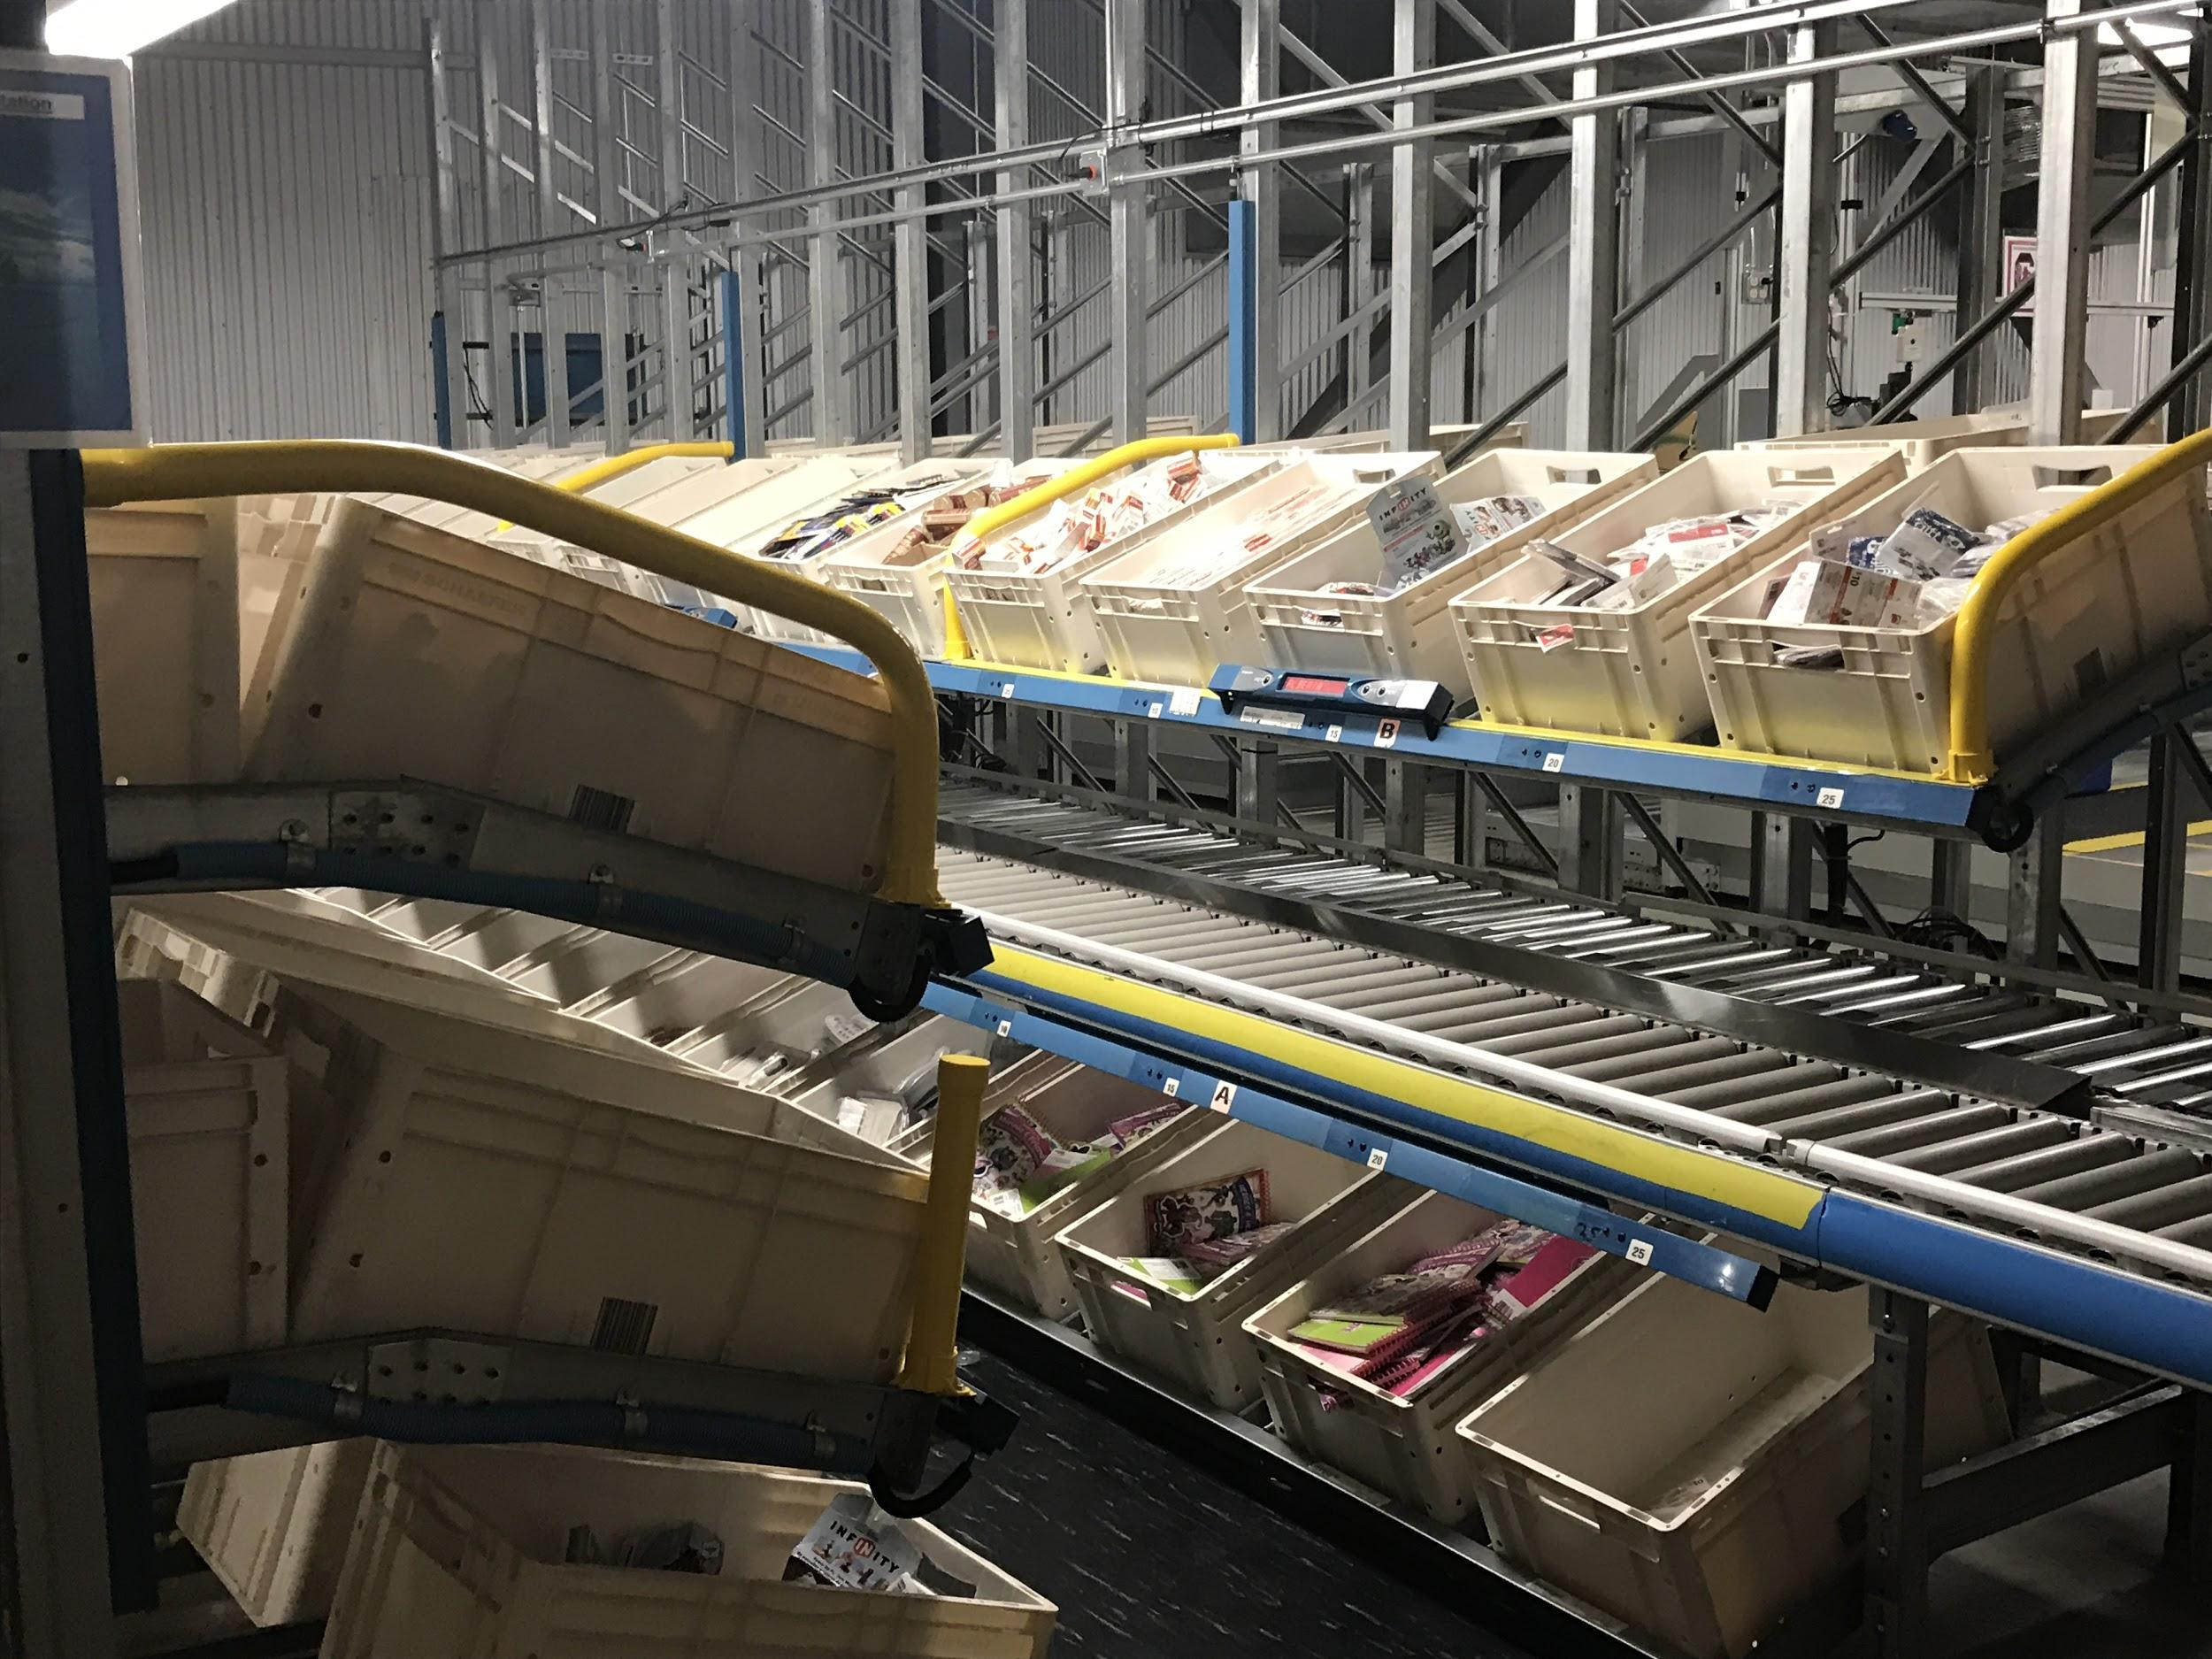
The LAB

Slide 21
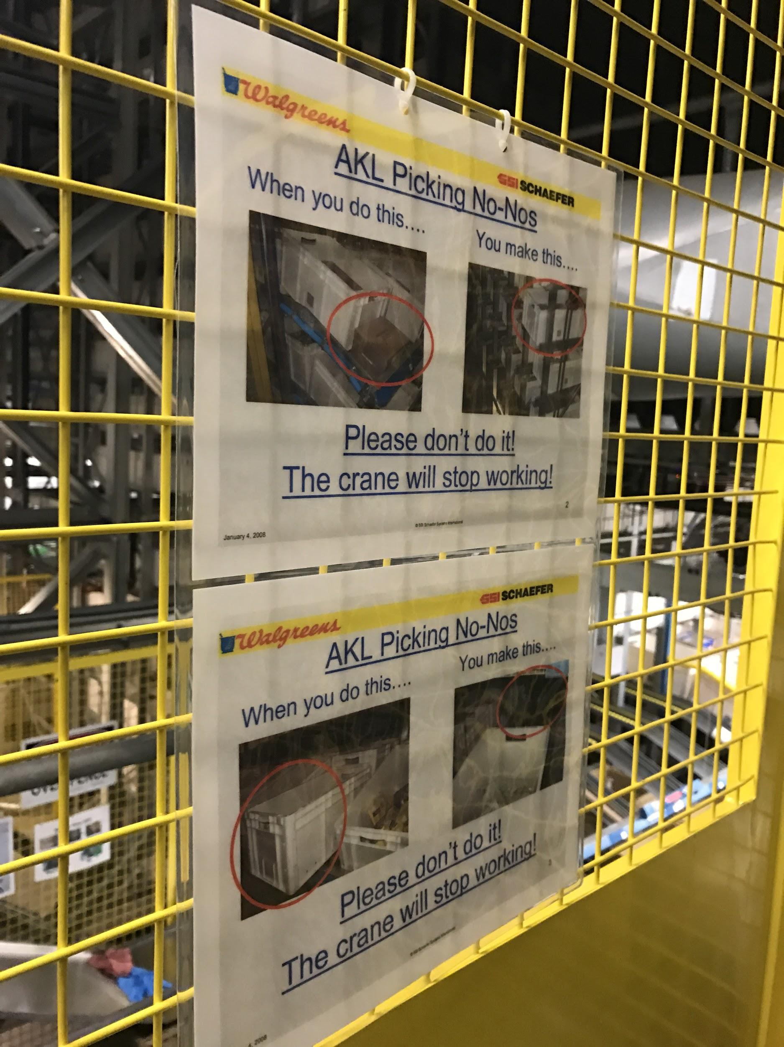
The power of WHY

Slide 22
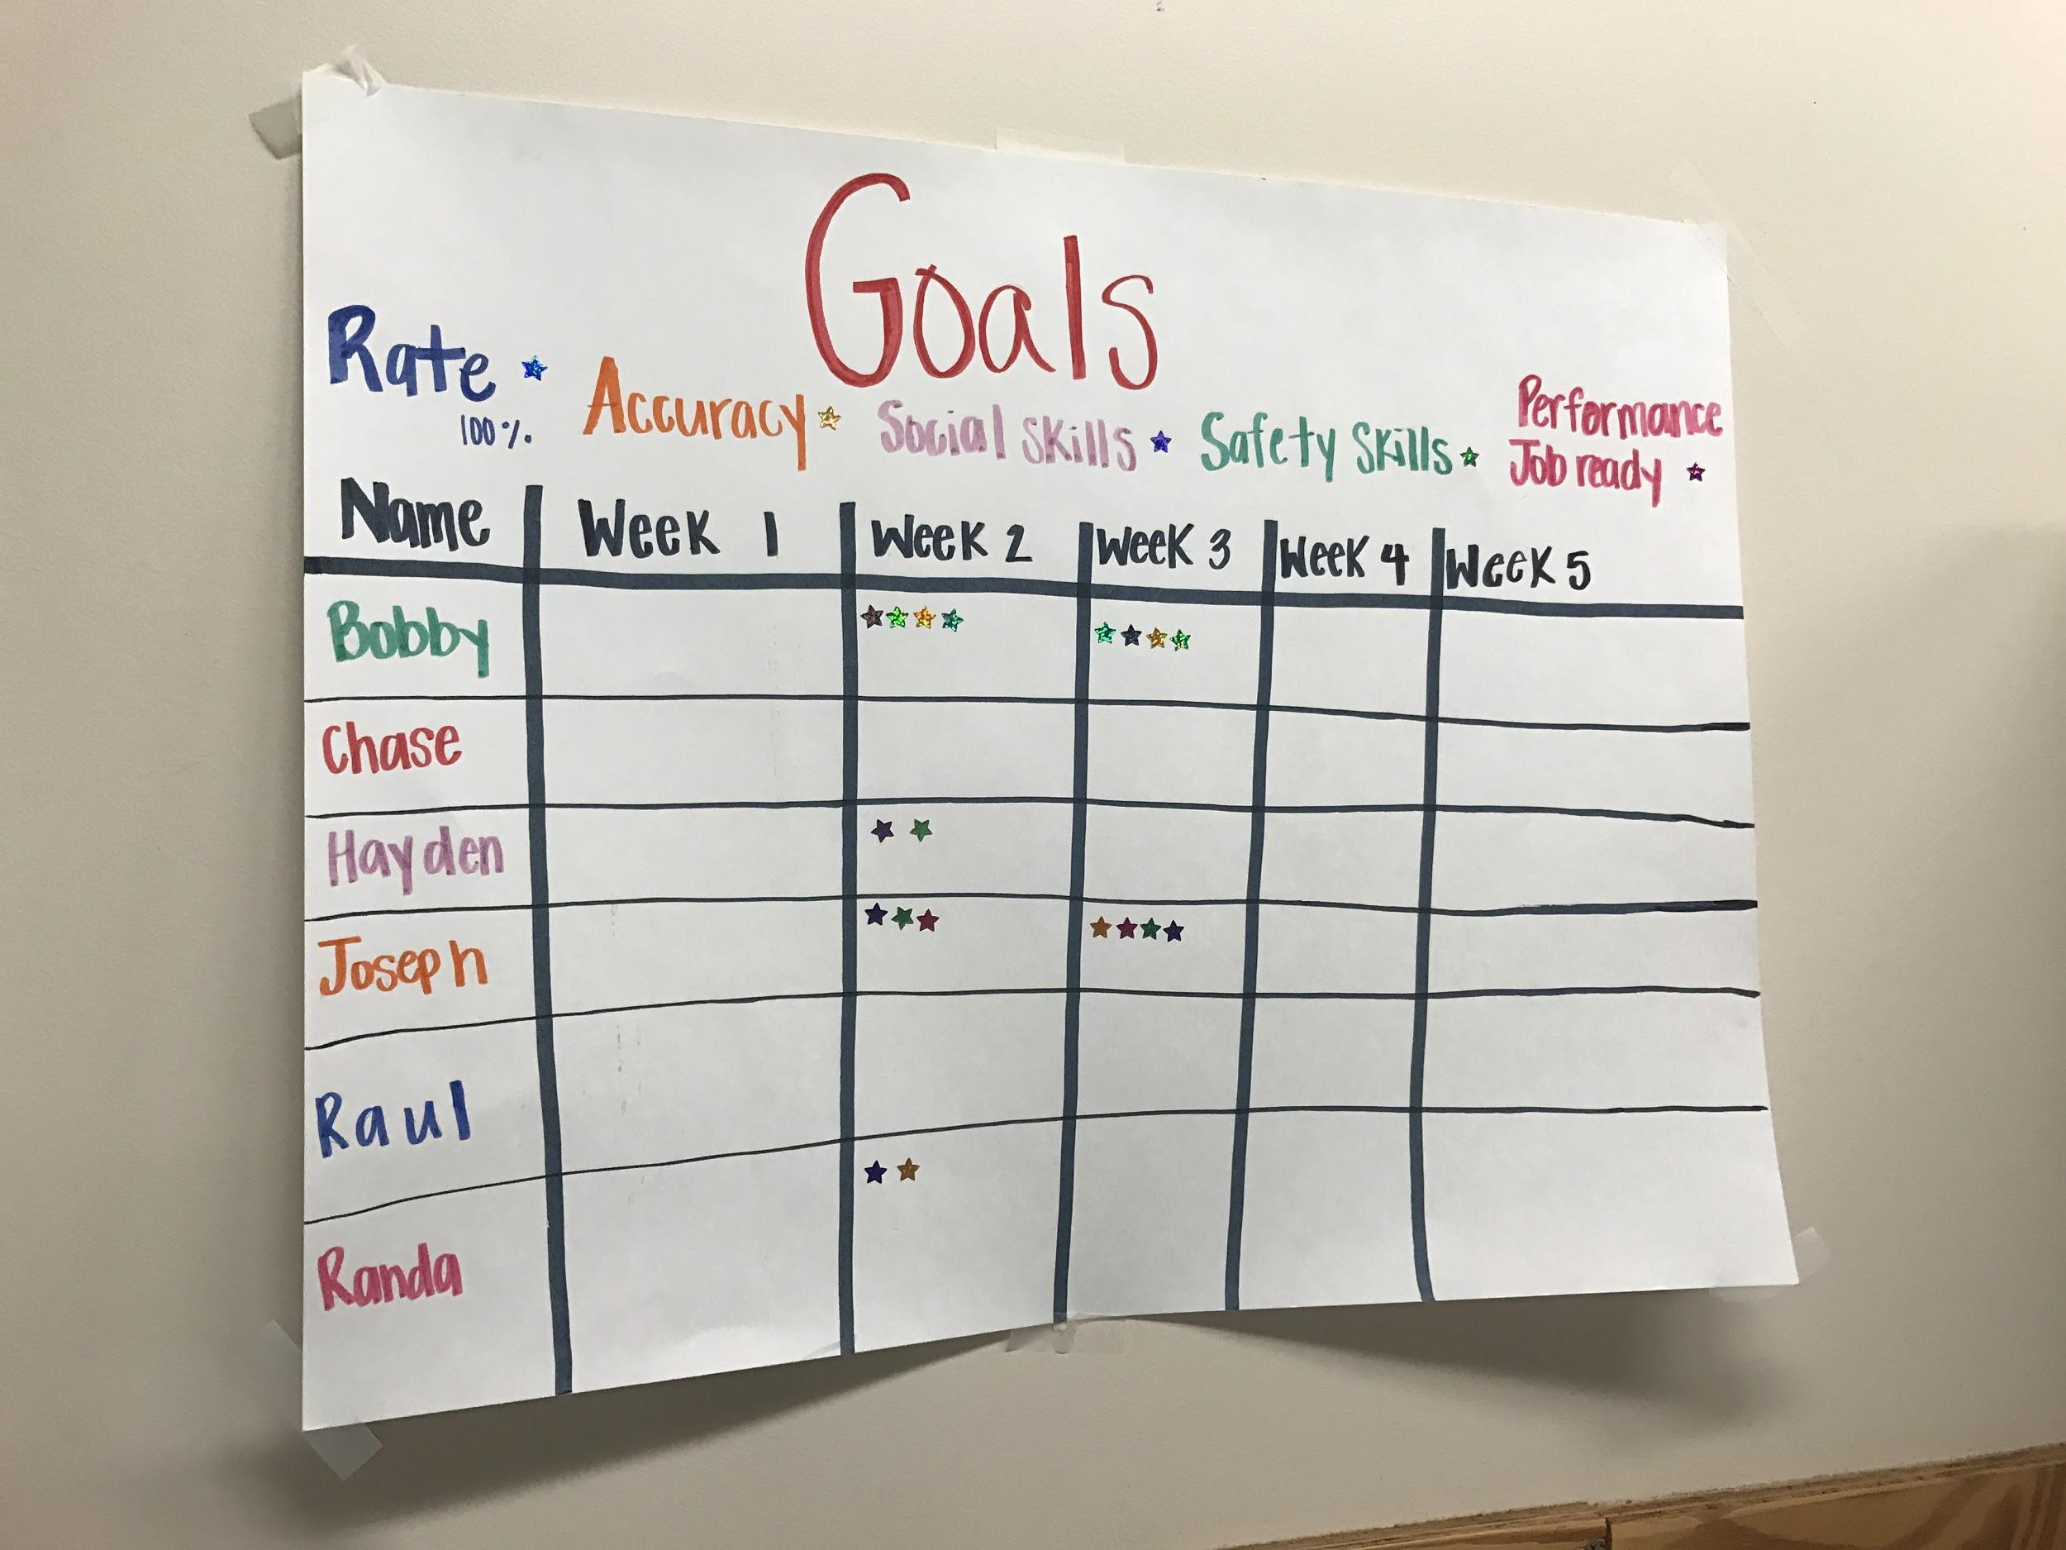
Cars, elevator buttons or cash?

Slide 23
RESULTS
Safety Productivity Absenteeism Engagement Attraction and Retention

Slide 24
Next steps
Find a champion
Dream BIG
ATP

Slide 25
“There is no greatness without goodness”
Randy Lewis

Slide 26
Lets change the world

Slide 27
THANK YOU
Please ask all the hard questions

Slide 28
Get in touch!
facebook.com/ANDisability
@ANDisability
linkedin.com/
company/
australian-network-on-disability
www.and.org.au
Notes:
Additional information is available on our website.

Slide 29
Survey Gizmo!
Notes:
Thank you for participating in our webinar today – we hope you have enjoyed the session.
When this webinar has finished you will be directed to an online survey.

